Slide 1
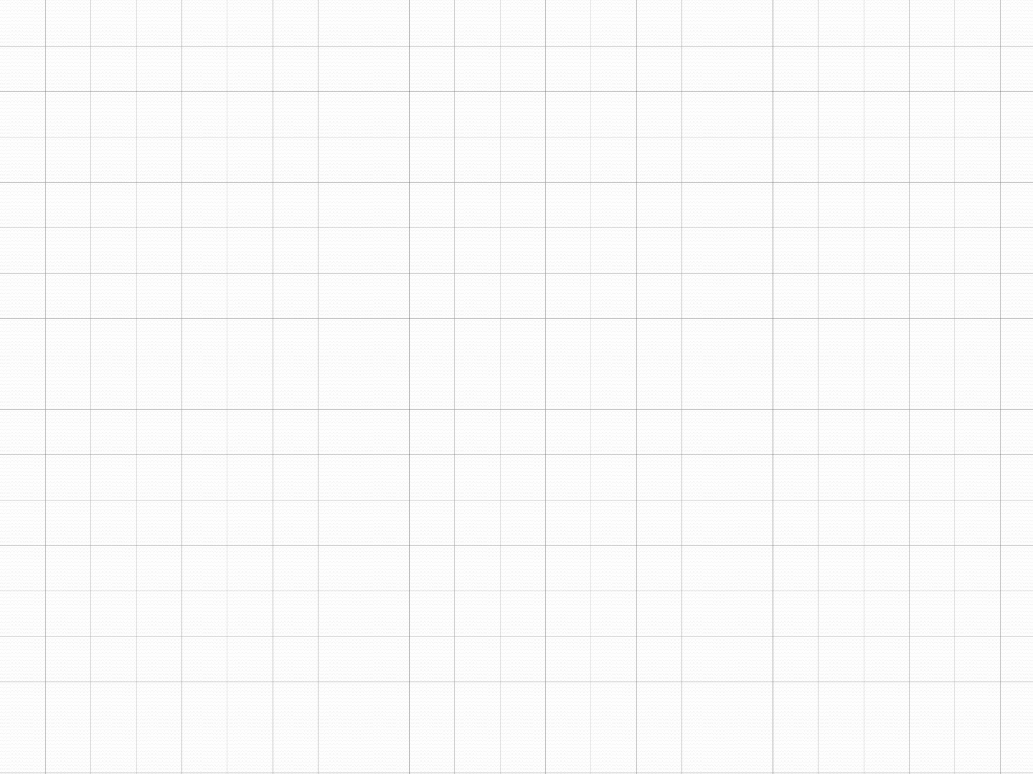


Data Structure
Graph
SHUBHAM AGGARWAL
181210052
CSE 2ND YEAR

Slide 2
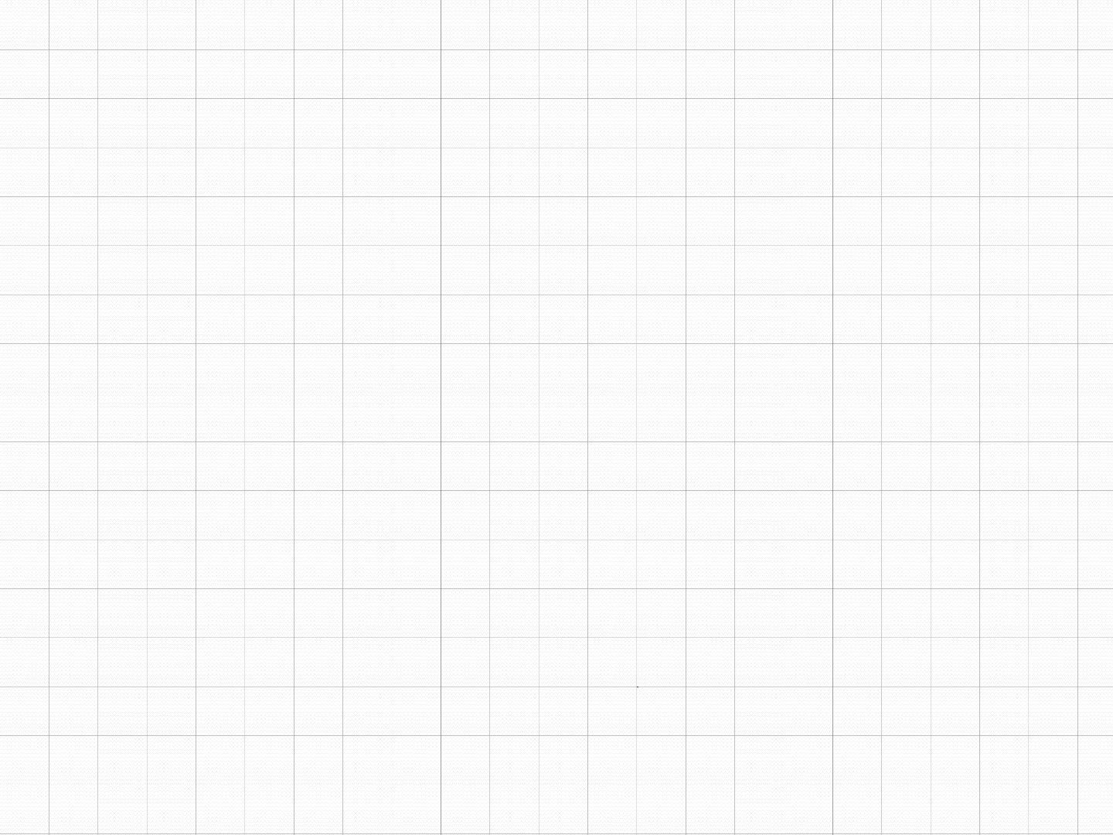
Graphs
A data structure that consists of a set of nodes (vertices) and a set of edges that relate the nodes to each other
The set of edges describes relationships among the vertices .
A graph G is defined as follows:
G=(V,E)
V(G): a finite, nonempty set of vertices
E(G): a set of edges (pairs of vertices)

Slide 3
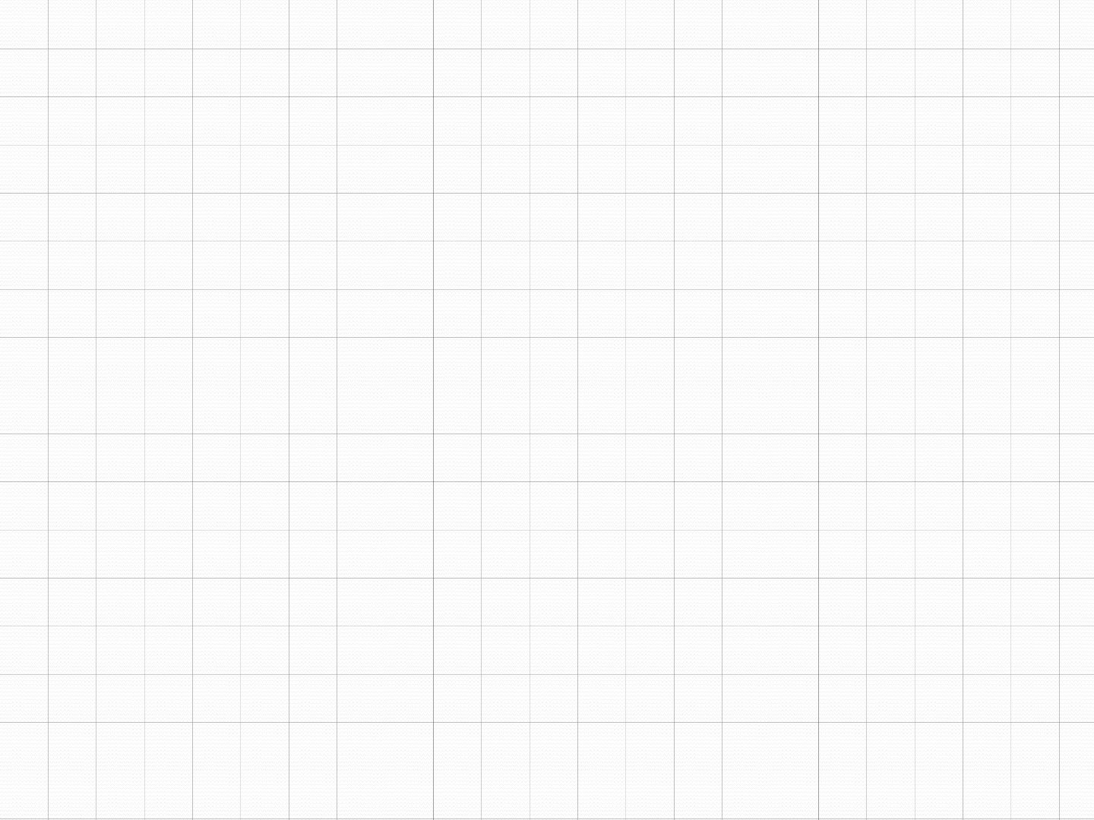


Examples of Graphs
V={0,1,2,3,4}
E={(0,1), (1,2), (0,3), (3,0), (2,2), (4,3)}
1
When (x,y) is an edge,
we say that x is adjacent to y, and y is adjacent from x.
is adjacent to 1.
is not adjacent to 0.
is adjacent from 1.
0
2
4
3

Slide 4
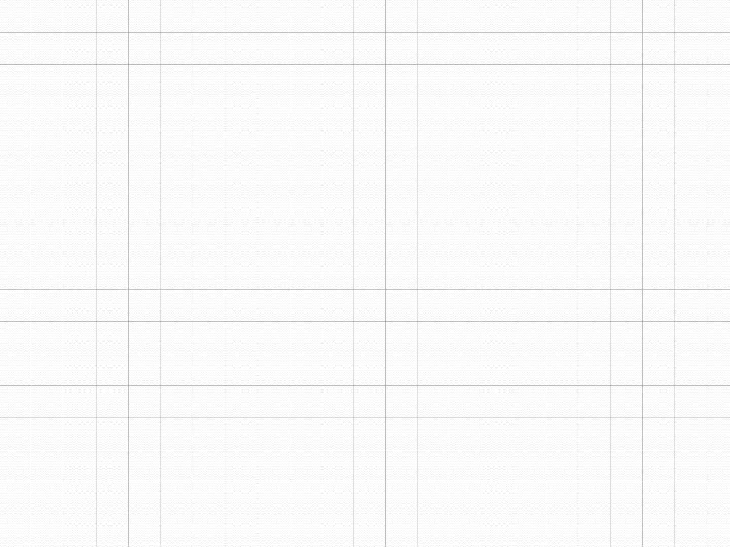
Directed vs. Undirected Graphs
Undirected edge has no orientation (no arrow head)
Directed edge has an orientation (has an arrow head)
Undirected graph – all edges are undirected
Directed graph – all edges are directed
u
v
u
directed edge
v
undirected edge

Slide 5
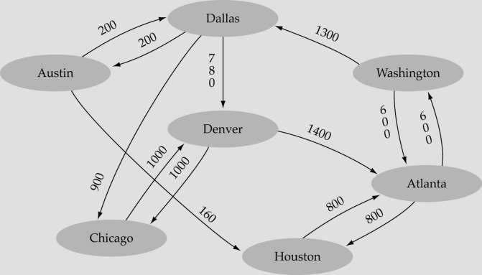
Weighted graph:
-a graph in which each edge carries a value

Slide 6
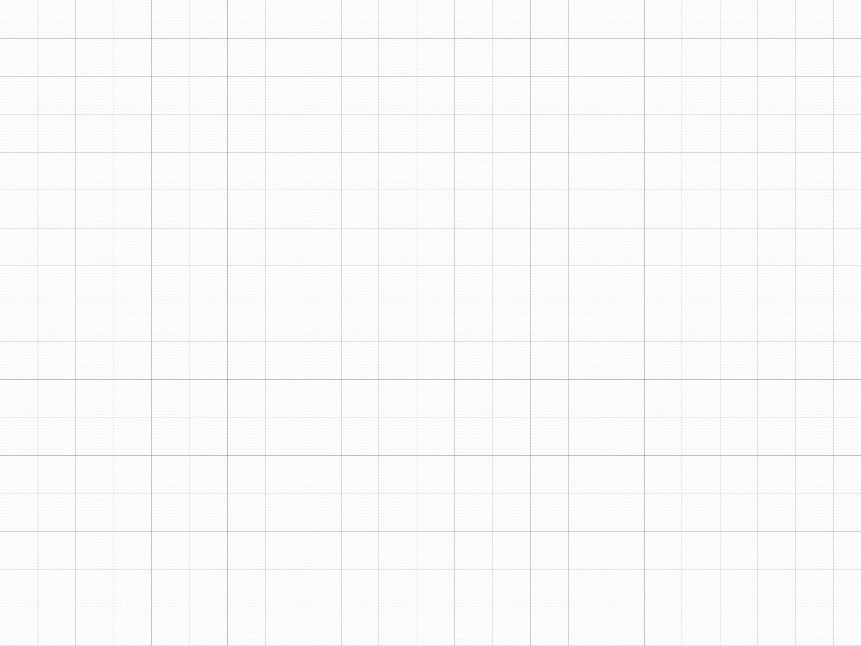
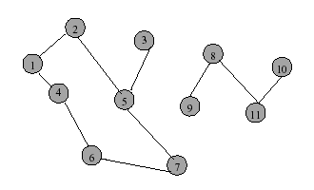
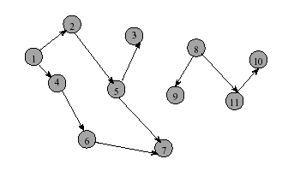
Directed graph
Directed Graph
Directed edge (i, j) is incident to vertex j and incident from vertex i
Vertex i is adjacent to vertex j, and vertex j is adjacent from vertex i
Undirected graph

Slide 7
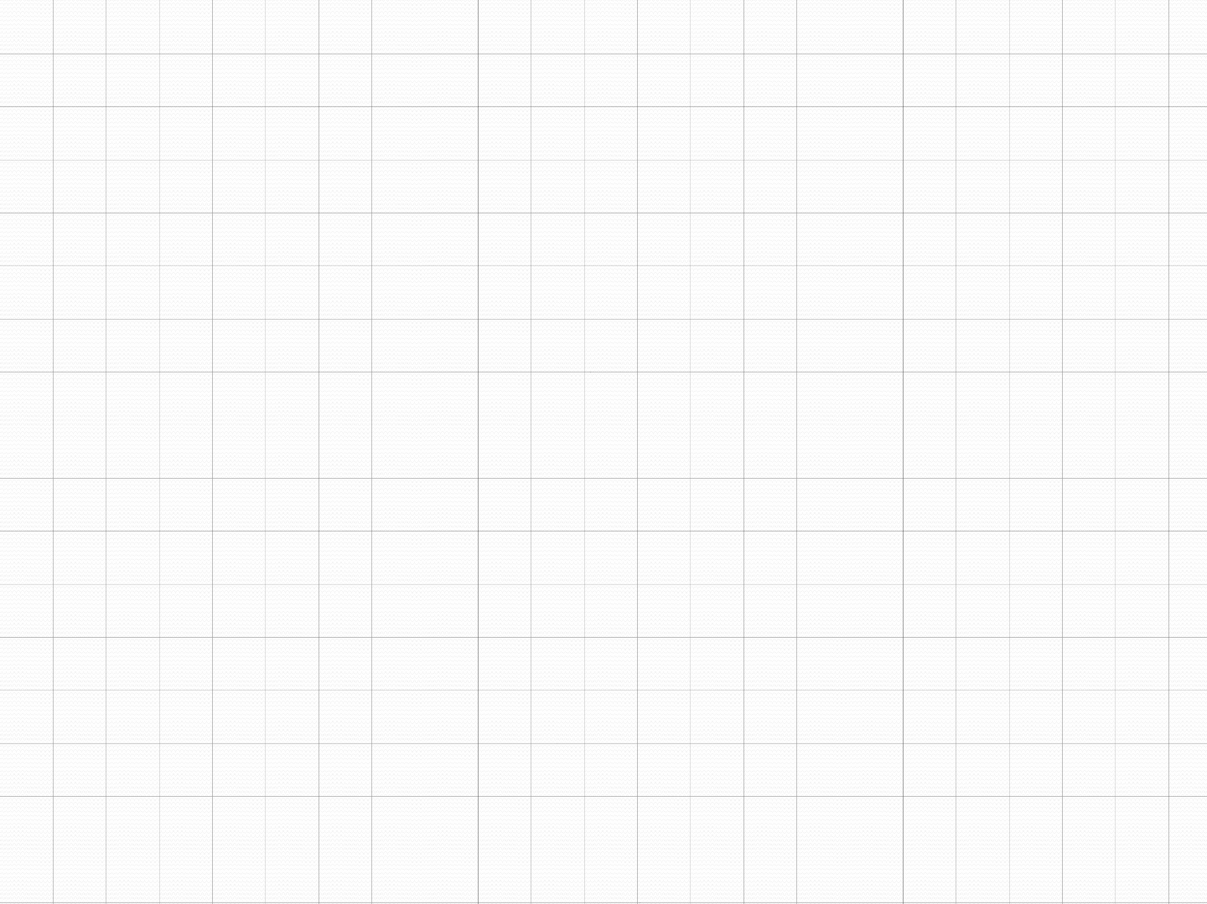

Graph terminology
Adjacent nodes: two nodes are adjacent if they are connected by an edge
5 is adjacent to 7
7 is adjacent from
Path: a sequence of vertices th⁵at connect two nodes in a graph
A simple path is a path in which all vertices, except possibly in the first and last, are different.
Complete graph: a graph in which every vertex is directly connected to every other vertex

Slide 8
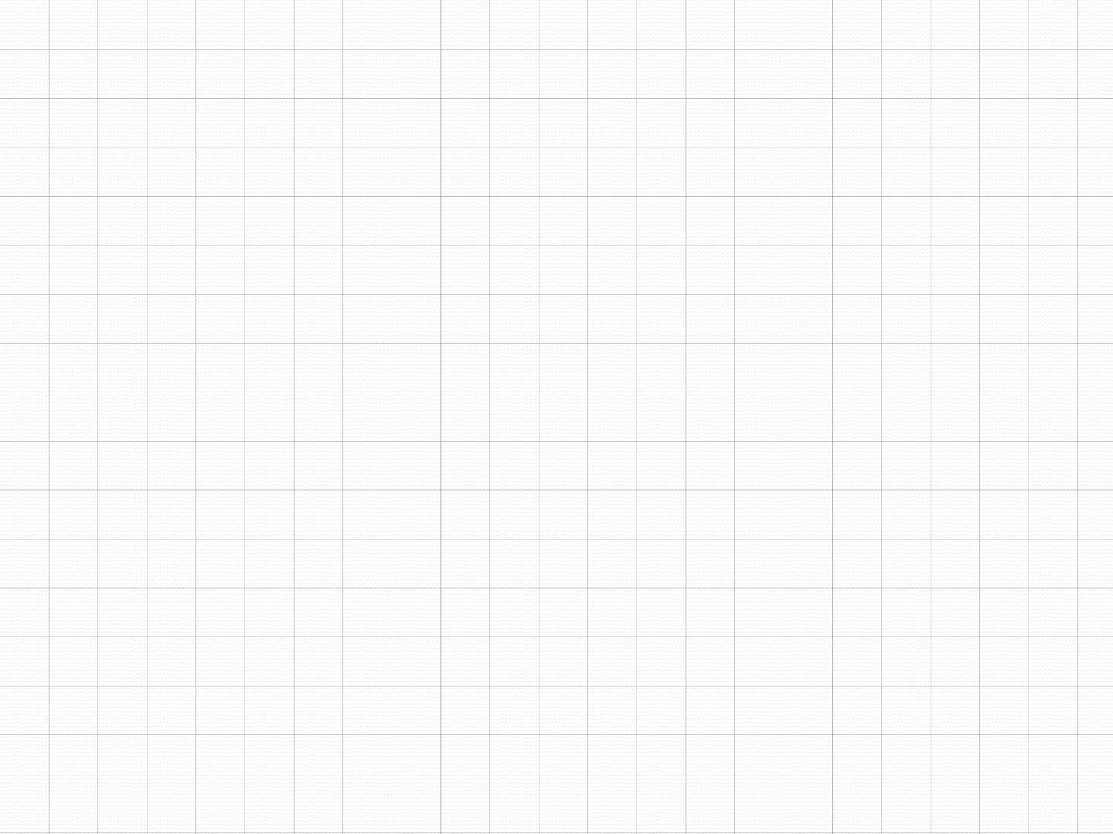
Continued…
A cycle is a simple path with the same start and end vertex.
The degree of vertex i is the no. of edges incident on vertex i.
e.g., degree(2) = 2, degree(5) = 3, degree(3) = 1

Slide 9
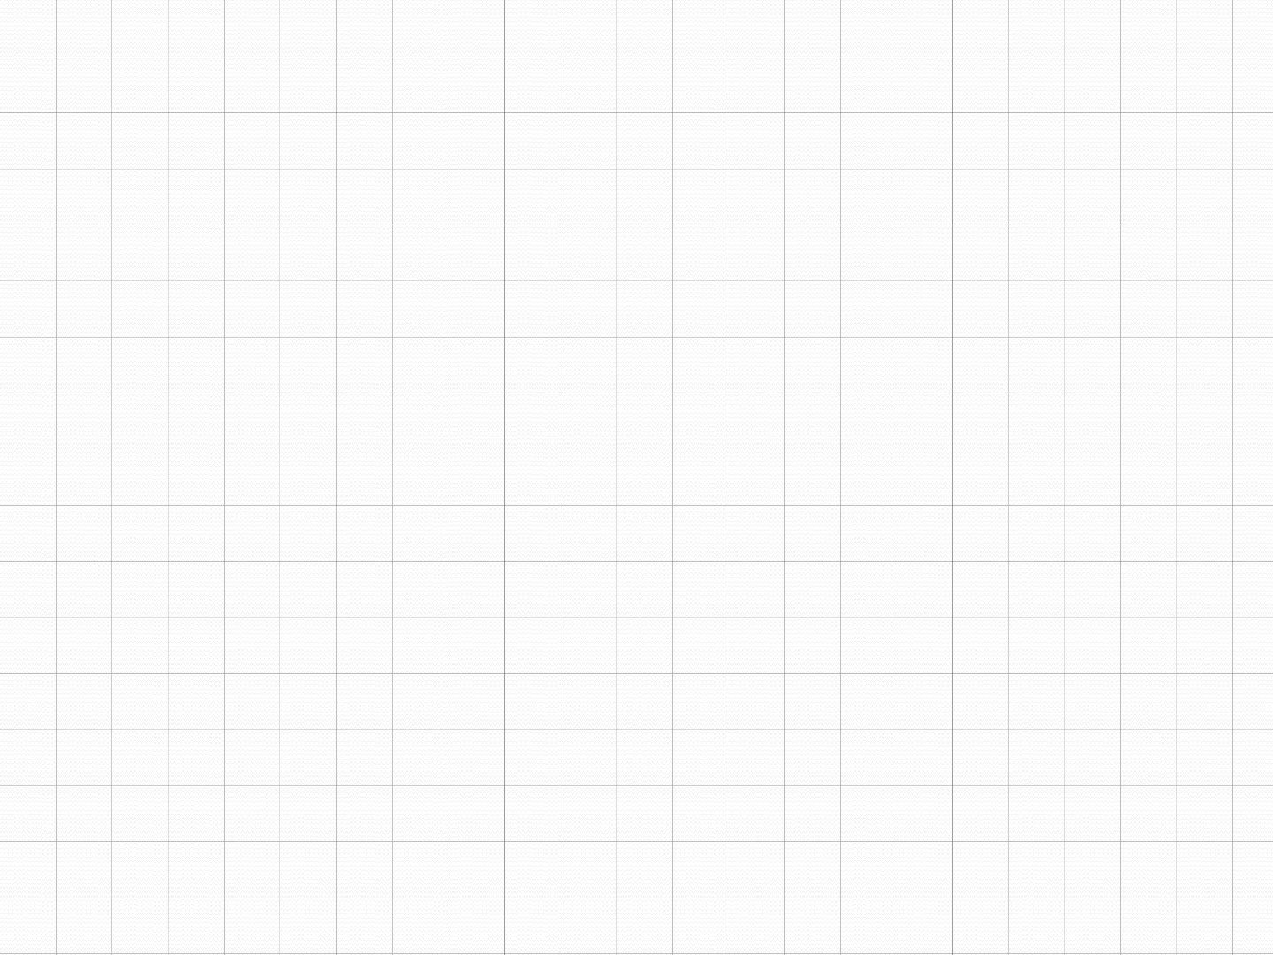
Continued…
Undirected graphs are connected if there is a path between any two vertices
Directed graphs are strongly connected if there is a path from any one vertex to any other
Directed graphs are weakly connected if there is a path between any two vertices, ignoring direction
A complete graph has an edge between every pair of vertices

Slide 10
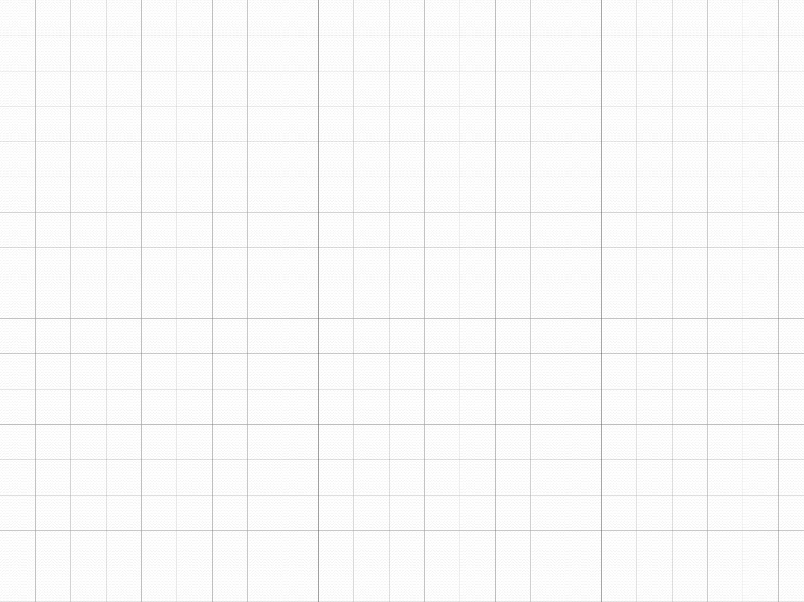
Continued…
Loops: edges that connect a vertex to itself
Paths: sequences of vertices p0, p1, … pm such that each adjacent pair of vertices are connected by an edge
A simple path is a path in which all vertices, except possibly in the first and last, are different.
Multiple Edges: two nodes may be connected by >1 edge
Simple Graphs: have no loops and no multiple edges

Slide 11
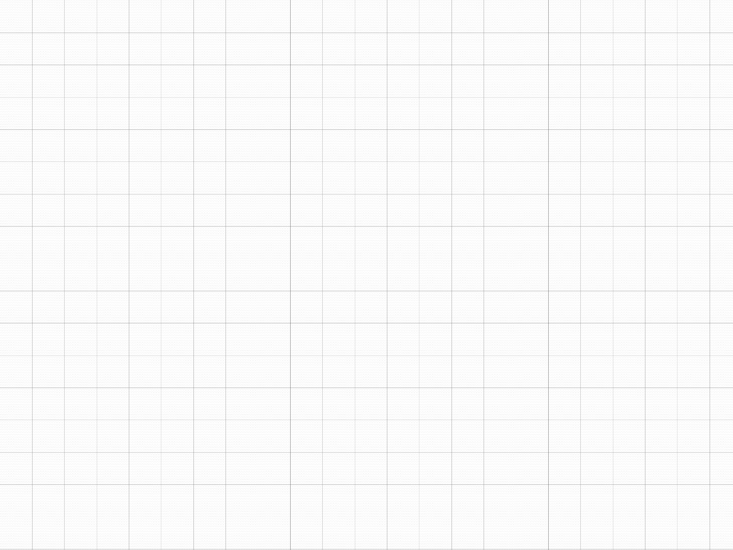
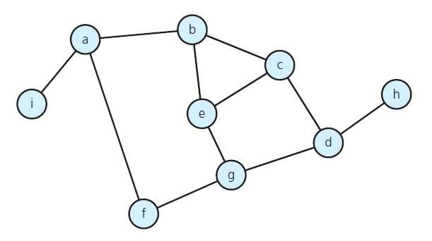
Graph Properties
Number of Edges – Undirected Graph
The no. of possible pairs in an n vertex graph is n*(n-1)
Since edge (u,v) is the same as edge (v,u), the number of edges in an undirected graph is n*(n- 1)/2.

Slide 12
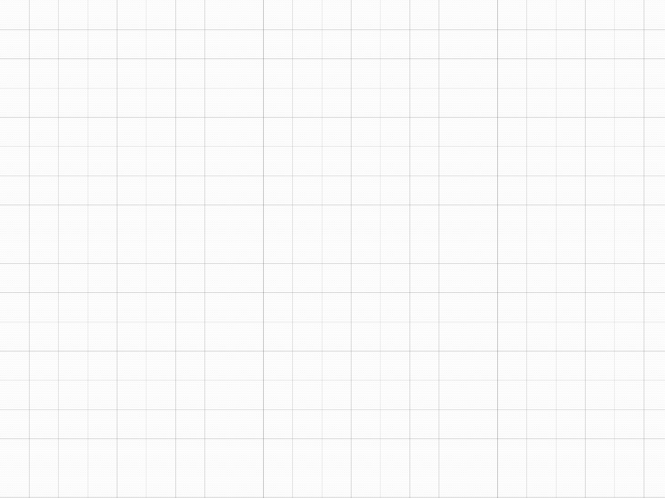
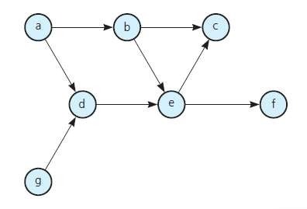
Number of Edges - Directed Graph
The no. of possible pairs in an n vertex graph is n*(n-1)
Since edge (u,v) is not the same as edge (v,u), the number of edges in a directed graph is n*(n-1)
Thus, the number of edges in a directed graph is ≤ n*(n-1)

Slide 13
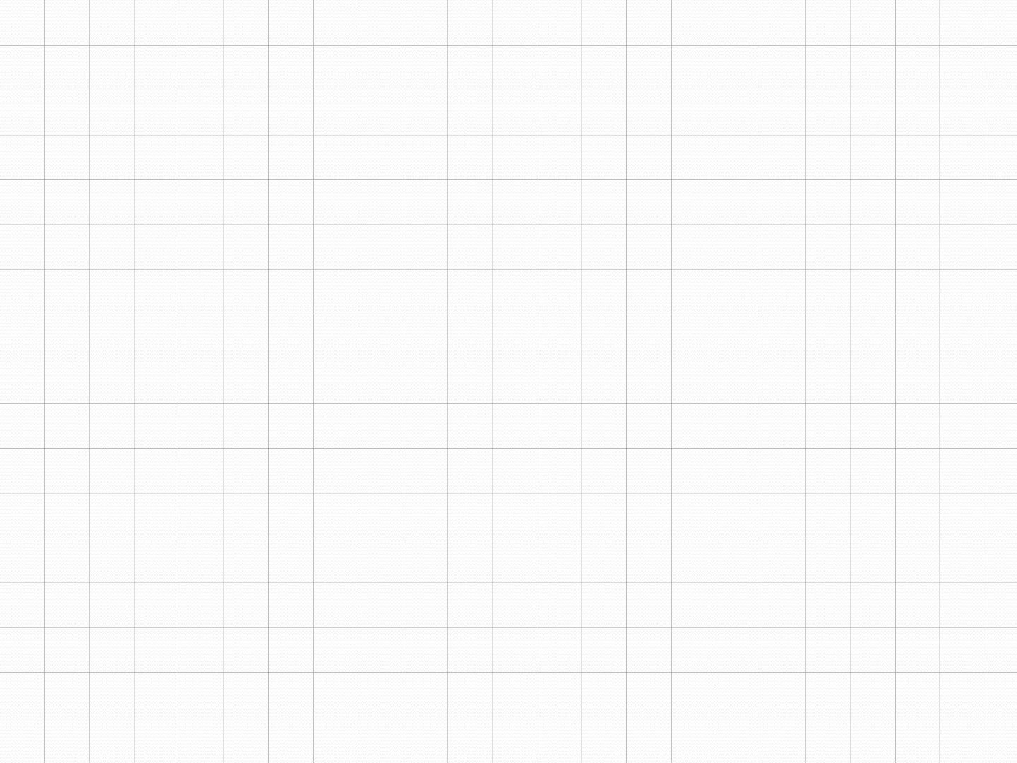

In-degree of vertex i is the number of edges incident to i (i.e., the number of incoming edges).
e.g., indegree(2) = 1, indegree(8) = 0
Out-degree of vertex i is the number of edges incident from i
(i.e., the number of outgoing edges). e.g., outdegree(2) = 1, outdegree(8) = 2

Slide 14
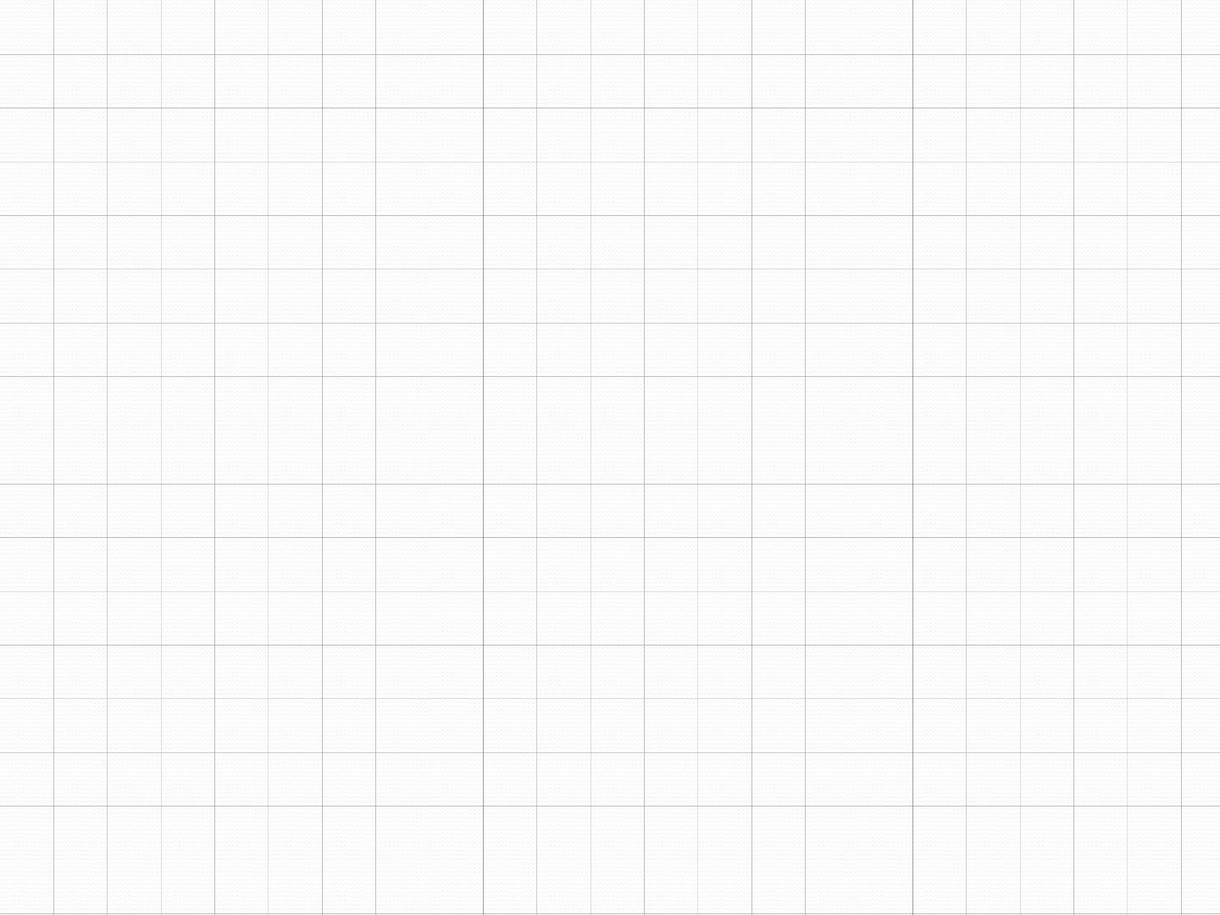
Graph Representation
For graphs to be computationally useful, they have to be conveniently represented in programs
There are two computer representations of graphs:
Adjacency matrix representation
Adjacency lists representation

Slide 15
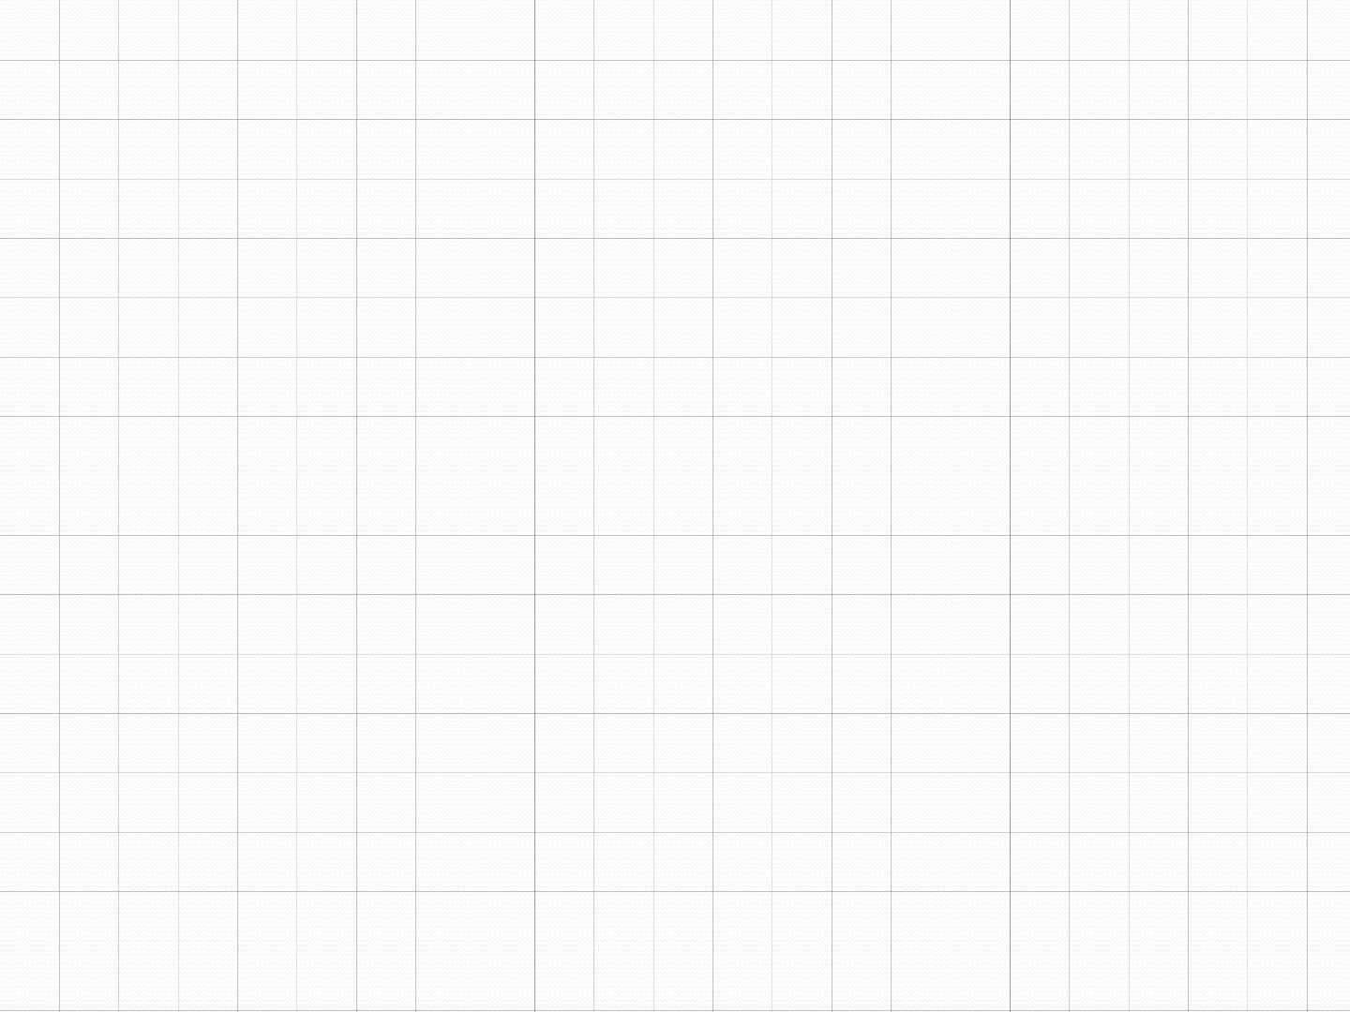
Adjacency Matrix
A square grid of boolean values
If the graph contains N vertices, then the grid contains N rows and N columns
For two vertices numbered I and J, the element at row I and column J is true if there is an edge from I to J, otherwise false

Slide 16
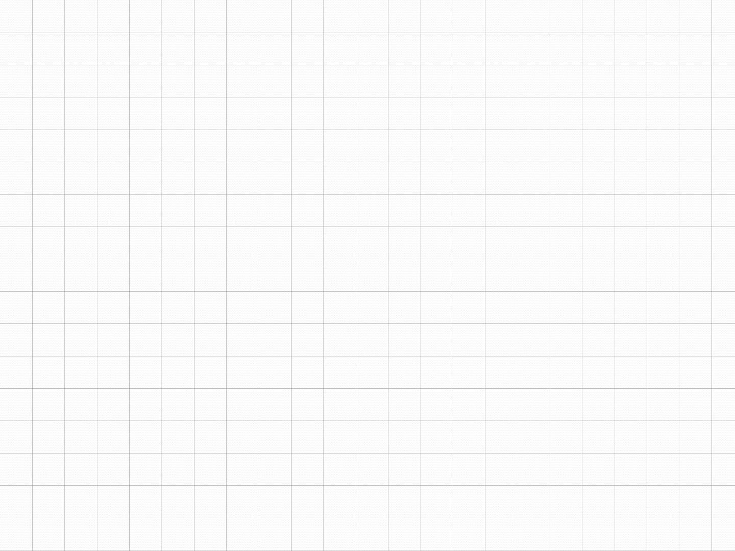
Adjacency Matrix
0
1
2
3
4
0 | false | false | true | false | false
1 | false | false | false | true | false
2 | false | true | false | false | true
3 | false | false | false | false | false
4 | false | false | false | true | false
1
3
2
4
0

Slide 17
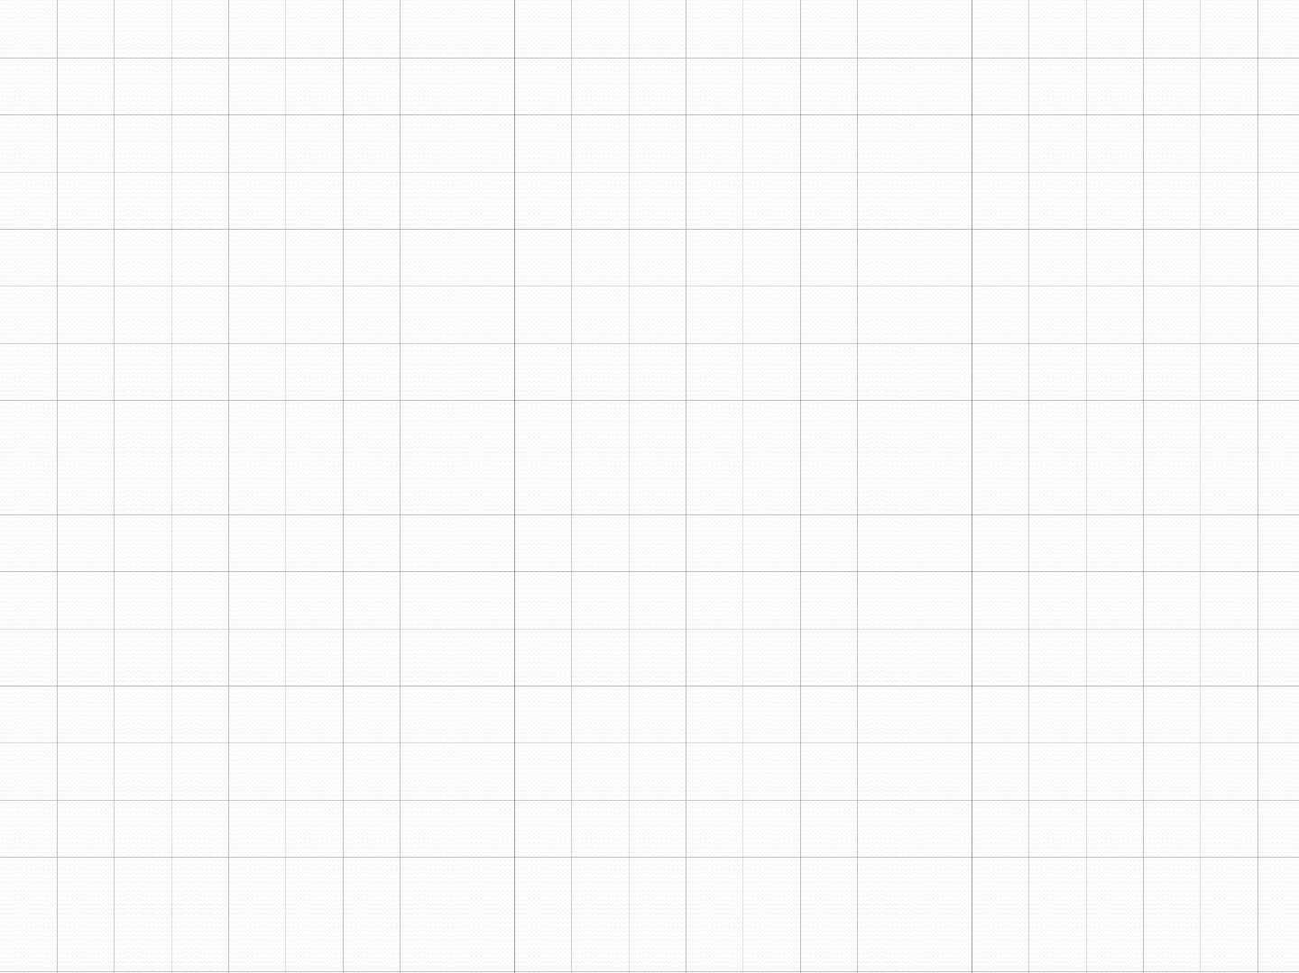
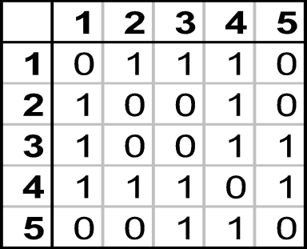
Adjacency Matrix
1
2
3
4
5

Slide 18
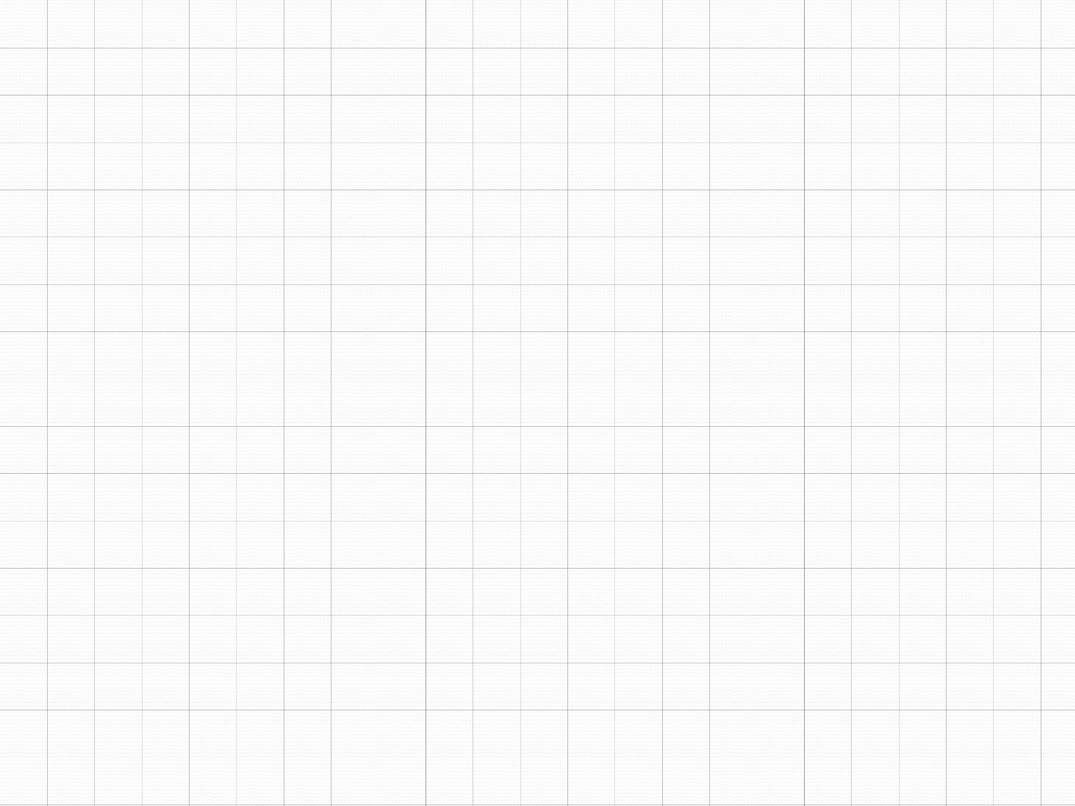
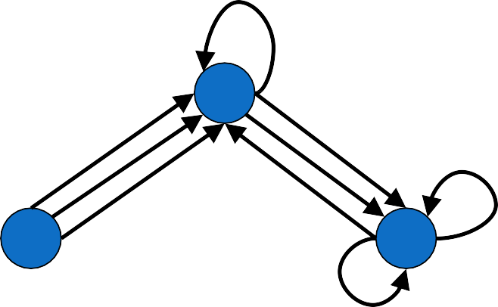
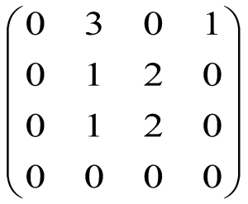
Adjacency Matrix
-Directed Multigraphs
2
1
4
3
A:
L23
18

Slide 19
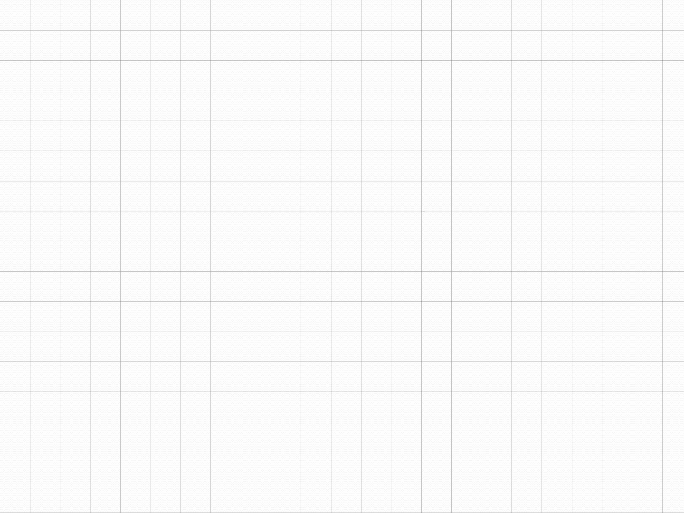
Adjacency Lists Representation
A graph of n nodes is represented by a one- dimensional array L of linked lists, where
L[i] is the linked list containing all the nodes adjacent from node i.
The nodes in the list L[i] are in no particular order
19

Slide 20
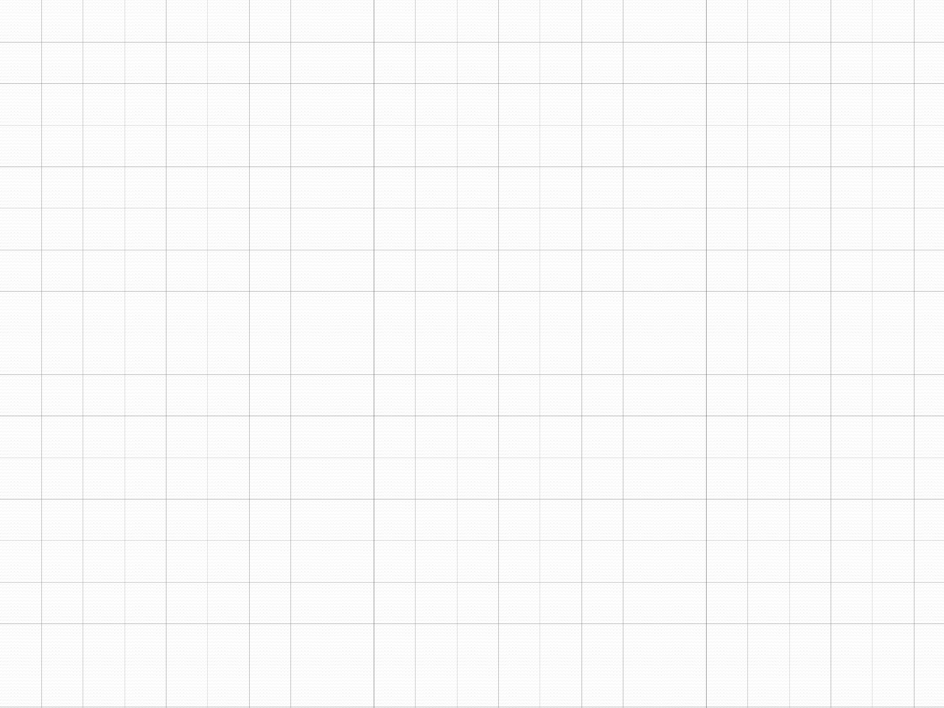
Graphs: Adjacency List
Adjacency list: for each vertex v ∈ V, store a list of vertices adjacent to v
Example:
Adj[1] = {2,3}
1
Adj[2] = {3}
Adj[3] = {}
Adj[4] = {3}
Variation: can also keep
a list of edges coming into vertex
2
4
3
20

Slide 21
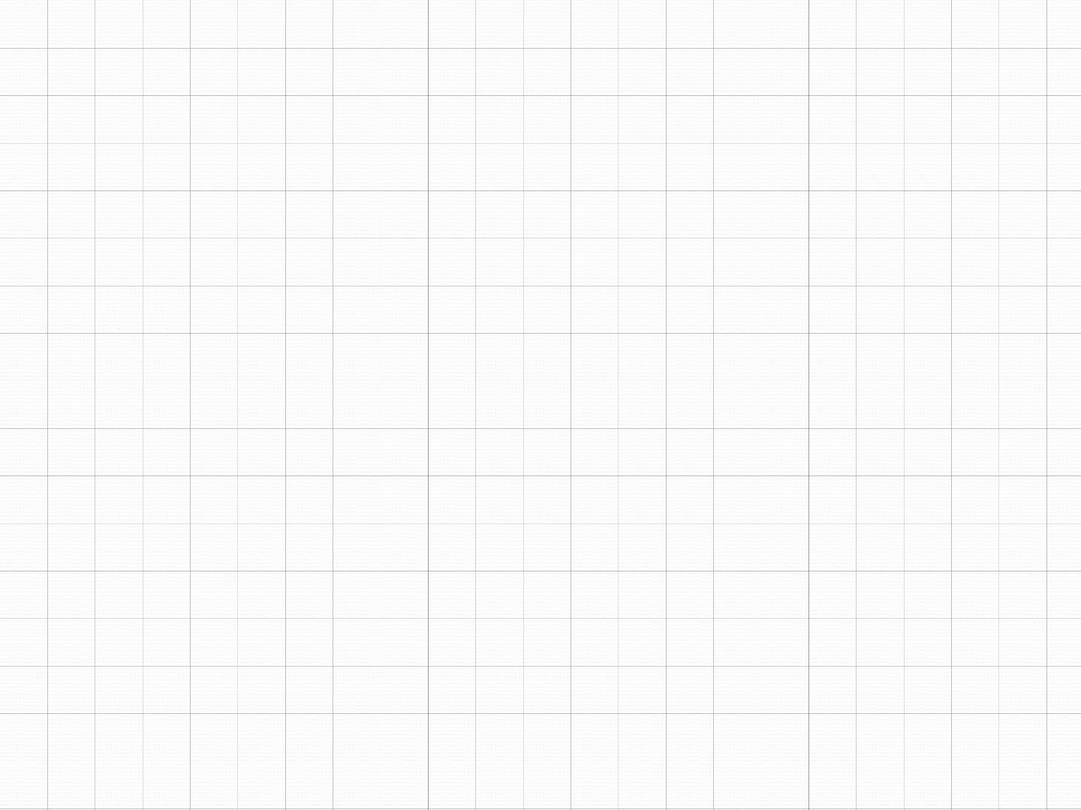
Graphs: Adjacency List
How much storage is required?
The degree of a vertex v = # incident edges
Directed graphs have in-degree, out-degree
For directed graphs, # of items in adjacency lists is
Σ out-degree(v) = |E|
For undirected graphs, # items in adjacency lists is Σ degree(v) = 2 |E|
So: Adjacency lists take O(V+E) storage
21

Slide 22
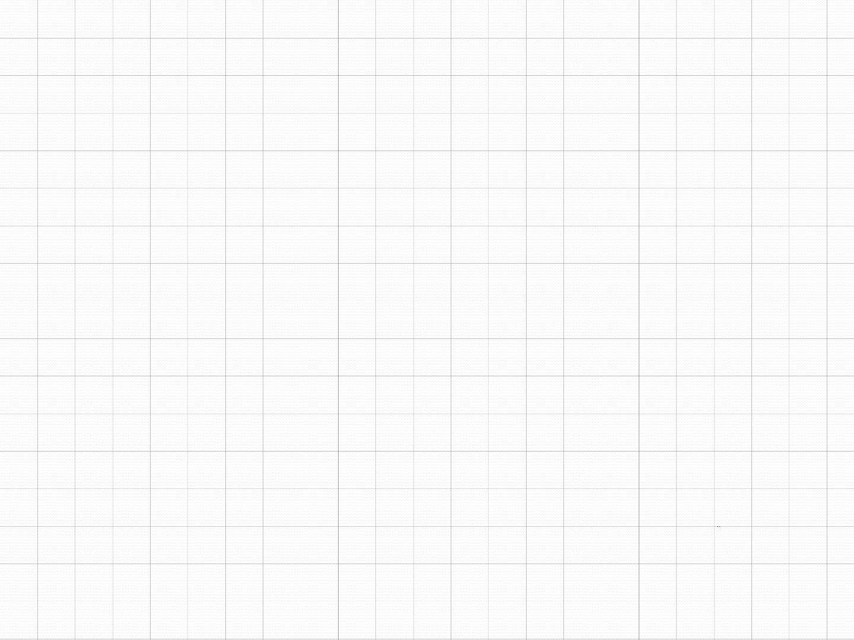
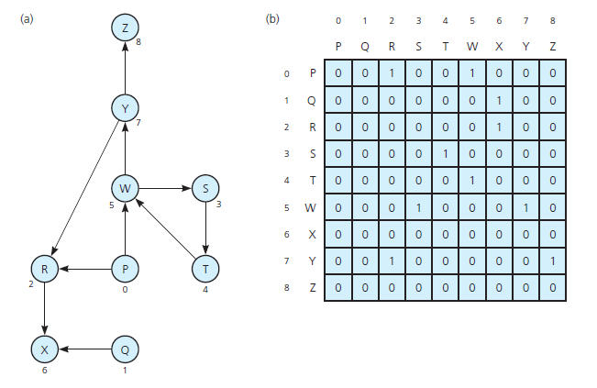
Implementing Graphs

Slide 23

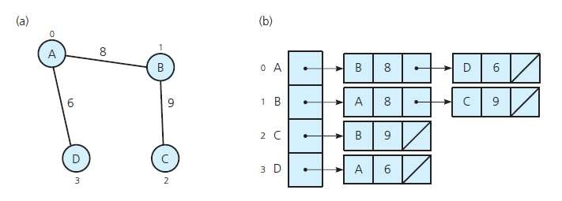
Implementing Graphs
(a) A weighted undirected graph and
(b) its adjacency list

Slide 24
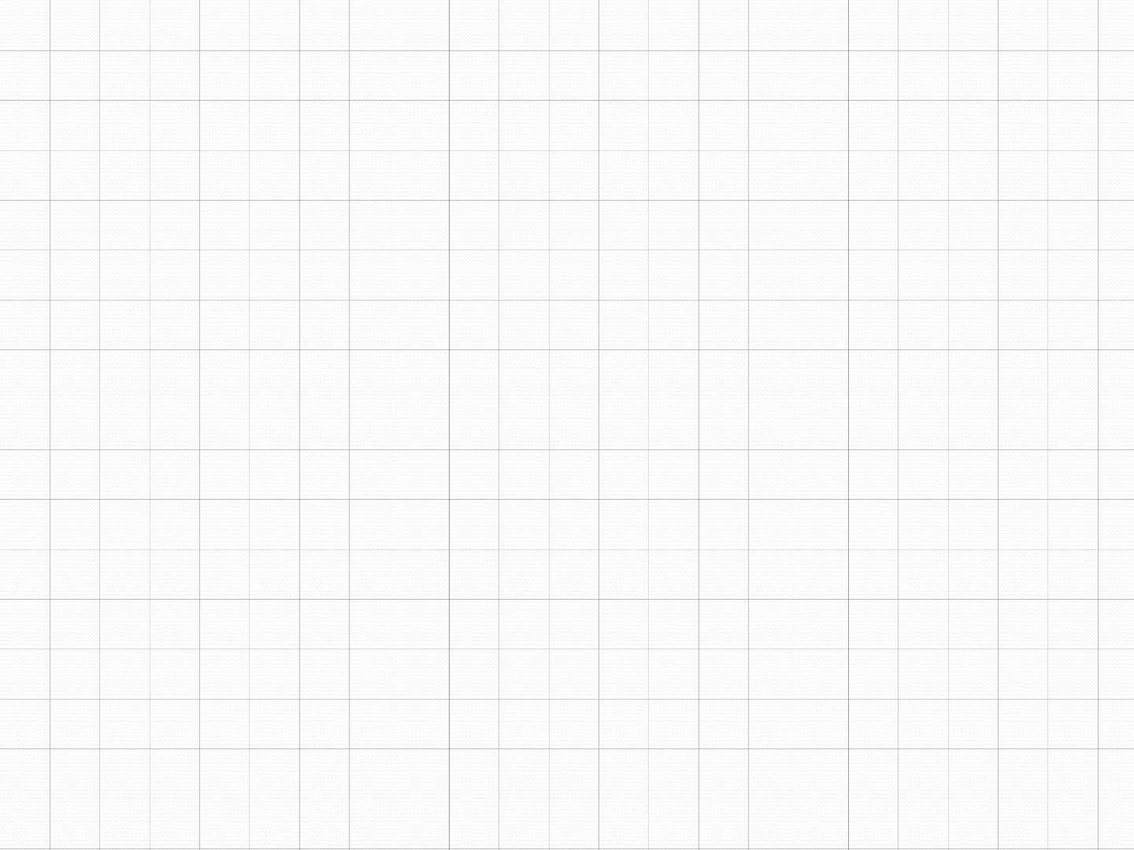
TRAVERSALS
To visit each node or vertex which is a connected component, tree-based algorithms are used. You can do this easily by iterating through all the vertices of the graph, performing the algorithm on each vertex that is still unvisited when examined.
Two algorithms are generally used for the traversal of a graph: Depth first search (DFS) and Breadth first search (BFS)
BFS gives level order print of the graph whereas inorder traversal is a type of DFS.
Graph
24

Slide 25
1. BREADTH FIRST SEARCH
BFS is a traversing algorithm where you should start traversing from a selected node (source or starting node) and traverse the graph layerwise thus exploring the neighbour nodes (nodes which are directly connected to source node). You must then move towards the next-level neighbour nodes.
As the name BFS suggests, you are required to traverse the graph breadthwise as follows:
First move horizontally and visit all the nodes of the current layer.
Move to the next layer.
Graph
24

Slide 26
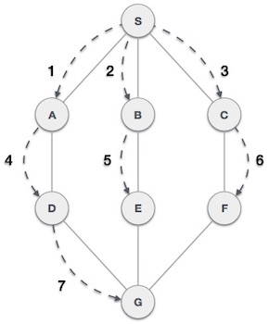

Slide 27
PSEUDOCODE
BFS (G, s) //Where G is the graph and s is the source node let Q be queue.
Q.enqueue( s ) //Inserting s in queue until all its neighbour vertices are marked.
mark s as visited.
while ( Q is not empty)
//Removing that vertex from queue,whose neighbour will be visited now
v = Q.dequeue( )
//processing all the neighbours of v
for all neighbours w of v in Graph G
if w is not visited
Q.enqueue( w )
//Stores w in Q to further visit its neighbour
mark w as visited.

Slide 28
2.DEPTH FIRST SEARCH
The DFS algorithm is a recursive algorithm that uses the idea of backtracking. It involves exhaustive searches of all the nodes by going ahead, if possible, else by backtracking.
Here, the word backtrack means that when you are moving forward and there are no more nodes along the current path, you move backwards on the same path to find nodes to traverse. All the nodes will be visited on the current path till all the unvisited nodes have been traversed after which the next path will be selected.
This recursive nature of DFS can be implemented using stacks. The basic idea is as follows: Pick a starting node and push all its adjacent nodes into a stack. Pop a node from stack to select the next node to visit and push all its adjacent nodes into a stack. Repeat this process until the stack is empty. However, ensure that the nodes that are visited are marked. This will prevent you from visiting the same node more than once. If you do not mark the nodes that are visited and you visit the same node more than once, you may end up in an infinite loop.

Slide 29
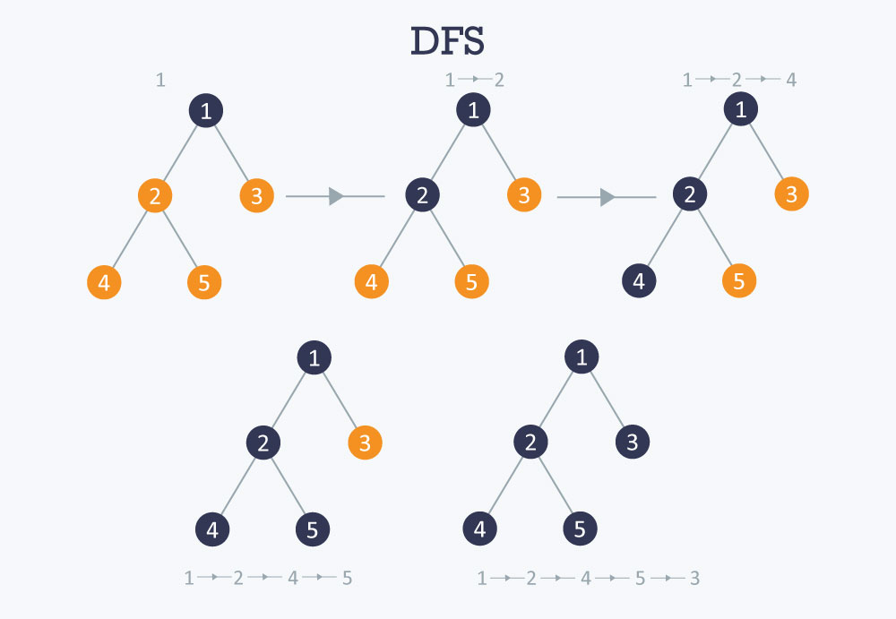

Slide 30
PSEUDOCODE
DFS-iterative (G, s): //Where G is graph and s is source vertex
let S be stack
S.push( s ) //Inserting s in stack
mark s as visited.
while ( S is not empty):
//Pop a vertex from stack to visit next
v = S.top( )
S.pop( )
//Push all the neighbours of v in stack that are not visited
for all neighbours w of v in Graph G:
if w is not visited :
S.push( w )
mark w as visited
DFS-recursive(G, s):
mark s as visited
for all neighbours w of s in Graph G:
if w is not visited:
DFS-recursive(G, w)

Slide 31
MINIMUM SPANNING TREE
The cost of the spanning tree is the sum of the weights of all the edges in the tree. There can be many spanning trees. Minimum spanning tree is the spanning tree where the cost is minimum among all the spanning trees. There also can be many minimum spanning trees.
Minimum spanning tree has direct application in the design of networks. It is used in algorithms approximating the travelling salesman problem, multi-terminal minimum cut problem and minimum-cost weighted perfect matching. Other practical applications are:
Cluster Analysis
Handwriting recognition
Image segmentation

Slide 32
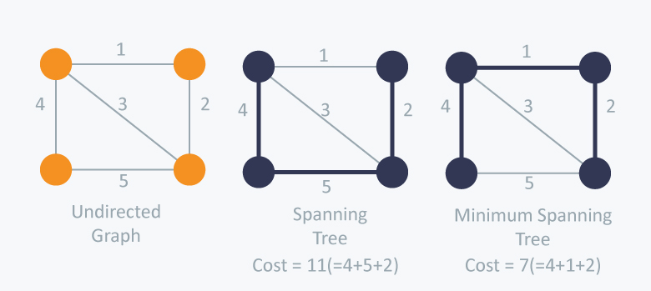

Slide 33
KRUSKAL’S ALGORITHM
Kruskal’s Algorithm builds the spanning tree by adding edges one by one into a growing spanning tree. Kruskal's algorithm follows greedy approach as in each iteration it finds an edge which has least weight and add it to the growing spanning tree.
So now the question is how to check if 2 vertices are connected or not ?
This could be done using DFS which starts from the first vertex, then check if the second vertex is visited or not. But DFS will make time complexity large as it has an order of O(V+E) where V is the number of vertices, E is the number of edges.
So the best solution is "Disjoint Sets": Disjoint sets are sets whose intersection is the empty set so it means that they don't have any element in common.

Slide 34
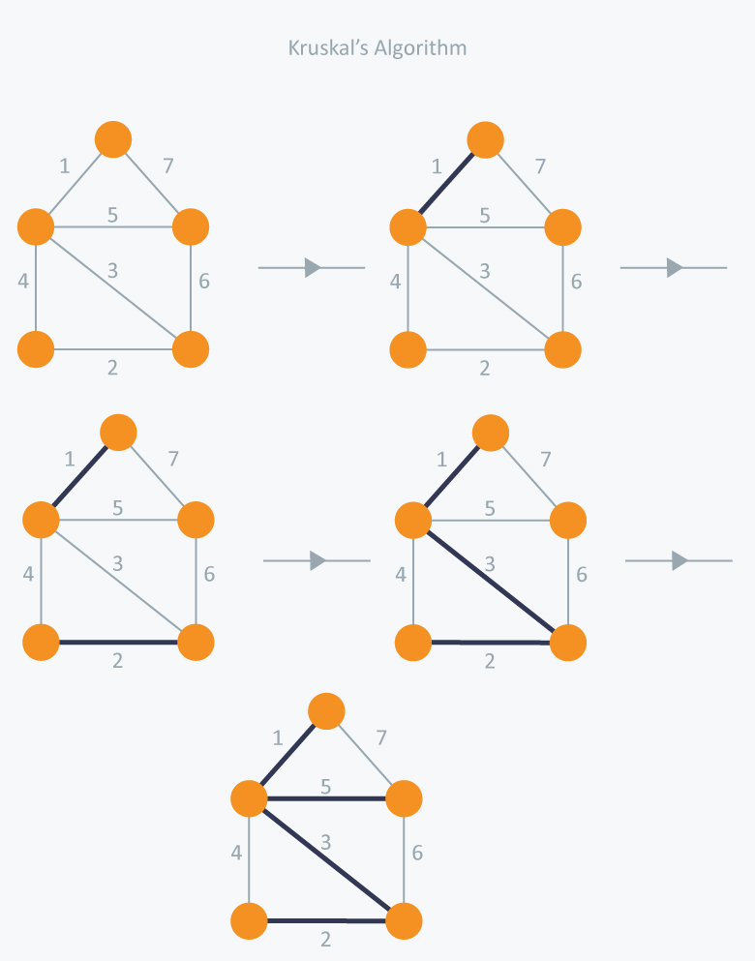

Slide 35
ALGORITHM
Sort the graph edges with respect to their weights.
Start adding edges to the MST from the edge with the smallest weight until the edge of the largest weight.
Only add edges which doesn't form a cycle , edges which connect only disconnected components.

Slide 36
PRIM’S ALGORITHM
Prim’s Algorithm also use Greedy approach to find the minimum spanning tree. In Prim’s Algorithm we grow the spanning tree from a starting position. Unlike an edge in Kruskal's, we add vertex to the growing spanning tree in Prim's.

Slide 37
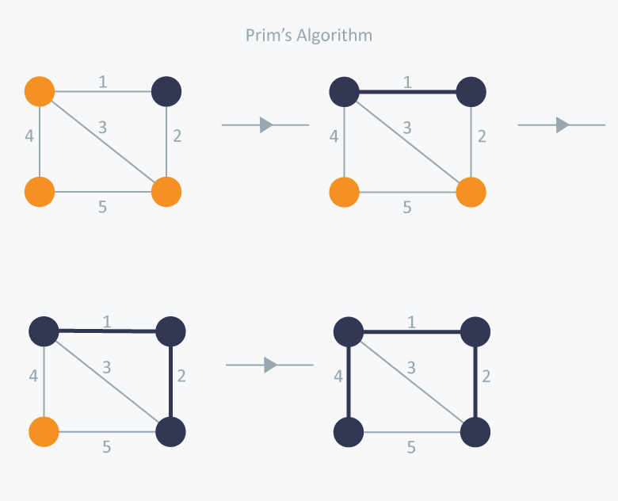

Slide 38
ALGORITHM
1) Create a set mstSet that keeps track of vertices already included in MST. 2) Assign a key value to all vertices in the input graph. Initialize all key values as INFINITE. Assign key value as 0 for the first vertex so that it is picked first. 3) While mstSet doesn’t include all vertices ….a) Pick a vertex u which is not there in mstSet and has minimum key value. ….b) Include u to mstSet. ….c) Update key value of all adjacent vertices of u. To update the key values, iterate through all adjacent vertices. For every adjacent vertex v, if weight of edge u-v is less than the previous key value of v, update the key value as weight of u-v

Slide 39
Shortest path Algorithms
Shortest path algorithms are a family of algorithms designed to solve the shortest path problem. The shortest path problem is something most people have some intuitive familiarity with: given two points, A and B, what is the shortest path between them?
In computer science, however, the shortest path problem can take different forms and so different algorithms are needed to be able to solve them all.

Slide 40
SINGLE SOURCE SHORTEST PATH
Single-source shortest path algorithms operate under the following principle:
Given a graph GG, with vertices VV, edges EE with weight function w(u,v)=wu,v​ , and a single source vertex, ss, return the shortest paths from ss to all other vertices in VV.
If the goal of the algorithm is to find the shortest path between only two given vertices, ss and tt, then the algorithm can simply be stopped when that shortest path is found. Because there is no way to decide which vertices to "finish" first, all algorithms that solve for the shortest path between two given vertices have the same worst-case asymptotic complexity as single-source shortest path algorithms.

Slide 41
Dijkstra's Algorithm
Dijkstra's algorithm has many variants but the most common one is to find the shortest paths from the source vertex to all other vertices in the graph.
Algorithm Steps:
Set all vertices distances = infinity except for the source vertex, set the source distance = 0.
Push the source vertex in a min-priority queue in the form (distance , vertex), as the comparison in the min-priority queue will be according to vertices distances.
Pop the vertex with the minimum distance from the priority queue (at first the popped vertex = source).
Update the distances of the connected vertices to the popped vertex in case of "current vertex distance + edge weight < next vertex distance", then push the vertex with the new distance to the priority queue.
If the popped vertex is visited before, just continue without using it.
Apply the same algorithm again until the priority queue is empty.

Slide 42
IMPLEMENTATION
#define SIZE 100000 + 1
vector < pair < int , int > > v [SIZE]; // each vertex has all the connected vertices with the edges weights
int dist [SIZE];
bool vis [SIZE];
void dijkstra(){
// set the vertices distances as infinity
memset(vis, false , sizeof vis); // set all vertex as unvisited
dist[1] = 0;
multiset < pair < int , int > > s; // multiset do the job as a min-priority queue
s.insert({0 , 1}); // insert the source node with distance = 0
while(!s.empty()){

Slide 43
IMPLEMENTATION(Cont.)
pair <int , int> p = *s.begin(); // pop the vertex with the minimum distance
s.erase(s.begin());
int x = p.s; int wei = p.f;
if( vis[x] ) continue; // check if the popped vertex is visited before
vis[x] = true;
for(int i = 0; i < v[x].size(); i++){
int e = v[x][i].f; int w = v[x][i].s;
if(dist[x] + w < dist[e] ){ // check if the next vertex distance could be minimized
dist[e] = dist[x] + w;
s.insert({dist[e], e} ); // insert the next vertex with the updated distance
}
}
}
}

Slide 44
ALL PAIRS SHORTEST PATH
All-pairs shortest path algorithms follow this definition:
Given a graph GG, with vertices VV, edges EE with weight function w(u,v)=w u,v return the shortest path from uu to vv for all u,v) in VV.
The most common algorithm for the all-pairs problem is the Floyd-warshall algorithm. This algorithm returns a matrix of values MM, where each cell Mi,j​ is the distance of the shortest path from vertex i to vertex j. Path reconstruction is possible to find the actual path taken to achieve that shortest path, but it is not part of the fundamental algorithm.

Slide 45
FLOYD-WARSHALL’S ALGORITHM
Floyd–Warshall's Algorithm is used to find the shortest paths between between all pairs of vertices in a graph, where each edge in the graph has a weight which is positive or negative. The biggest advantage of using this algorithm is that all the shortest distances between any 2 vertices could be calculated in O(V3), where V is the number of vertices in a graph.

Slide 46
ALGORITHMIC STEPS
For a graph with N vertices:
Initialize the shortest paths between any 2 vertices with Infinity.
Find all pair shortest paths that use 0 intermediate vertices, then find the shortest paths that use 1 intermediate vertex and so on.. until using all N vertices as intermediate nodes.
Minimize the shortest paths between any 2 pairs in the previous operation.
For any 2 vertices (i,j) , one should actually minimize the distances between this pair using the first K nodes, so the shortest path will be: min(dist[i][k]+dist[k][j],dist[i][j]).

Slide 47
IMPLEMENTATION
for(int k = 1; k <= n; k++){
for(int i = 1; i <= n; i++){
for(int j = 1; j <= n; j++){
dist[i][j] = min( dist[i][j], dist[i][k] + dist[k][j] );
}
}
}

Slide 48
BIBLIOGRAPHY
https://www.hackerearth.com/practice/algorithms/graphs

Slide 49
THANK YOU

